Slide 1


DOEHRS-HC Audiogram Entry Practicum
Tri-Service Hearing Technician
4.2 Certification Course

Slide 2
DOEHRS-HC Audiogram Entry Practicum
Learning Objectives
4.1.1 Manually enter audiograms from an audiological evaluation
4.1.2 Understand how the sub-table/fields data entry affects patient audiograms
4.1.3 Add examiner information correctly
4.1.4 Add audiometer correctly
4.1.5 Correctly enter audiograms test site, date/time and thresholds
Tri-Service Hearing Technician 4.2.0.0 Certification Course

Slide 3
DOEHRS-HC Audiogram Entry Practicum
Background Information
Entering data from scratch may require inputting sub-fields, right click from current window
  Patient UIC, Examiner identity with test site installation, Audiometer
Enter date and time audiogram was completed
  If more than 1 audiogram is being entered from the same evaluation, enter audiogram series correctly, enter time of sequential tests in 1 minute increments (example: 0800/0801)
Selection of audiogram test type and/or reason
Tri-Service Hearing Technician 4.2.0.0 Certification Course
Notes:
What was one of the disadvantages of manual audiometry? More susceptible to data entry errors
Who conducted the audiogram? Audiologist
What type of audiometer does the audiologist use? Manual

Slide 4
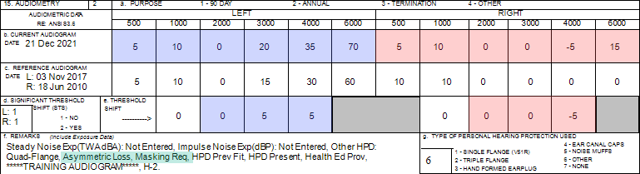
DOEHRS-HC Audiogram Entry Practicum
Background Information
Patient [SSN = 990990024] asymmetrical hearing loss/masking required
Instructions from the audiologist:
  Left ear STS, enter 2216 both ears, re-establish baseline left ear
  Test selection - 2216
  Demographic sheet, Referral, Evaluation provided
Notes:
AS = Left ear; AU = Both ears; enter a 2216 annual test for both ears, then enter a 2215 reference audiogram for the left ear.
Counseling? Change in hearing? Hearing within the range of normal? Where do they need to go?
Patient audiogram that referred to audiologist; next slide is the audiologist evaluation

Slide 5
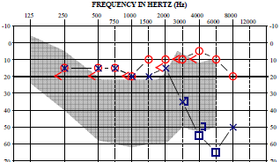
DOEHRS-HC Audiogram Entry Practicum
Background Information
Thresholds correctly entered
Frequencies entered on a 2215/2216 or a NHC are?
Thresholds on this evaluation go from _____ Hz to _____ Hz
Notes:
Enter 500 Hz, 1000 Hz, 2000 Hz, 3000 Hz, 4000 Hz, 6000 Hz
Do not enter 250 Hz, 750 Hz, 1500 Hz, 8000 Hz
Inter-octaves = 750 Hz, 1500, 3000, 6000, 12000 Hz
Left ear identified by blue X or ]
Right ear identified by red 0
Left ear normal hearing?
Right ear normal hearing?
Cross over occurs? 40-45 decibels
Masking keeps the better ear busy while testing the worst ear.
Briefly review the audiogram graph and how to read it

Slide 6
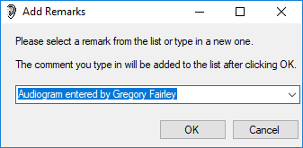
DOEHRS-HC Audiogram Entry Practicum
Background Information
There is at least 1 or more pieces of information you will have to get from the facilitators
All manually entered audiograms require an electronic remark
  Audiogram entered by (name)
  Always add remarks by pressing the add remarks button, do not enter directly into the remarks box
Data integrity is very important
Tri-Service Hearing Technician 4.2.0.0 Certification Course
Notes:
Entering data directly into the remarks box does not electronically attach to the record; entering it in the add remarks location does.
If the examiner is not in the drop down window you____________?
Right click to add them in; need complete examiner information in order to add to include the site where the test was completed

Slide 7
DOEHRS-HC Audiogram Entry Practicum
Complete Practicum
This practicum simulates the practical exam on day 5
A disadvantage of DOEHRS-HC manual data entry is human error
Write down the thresholds that need to be entered (space above the evaluation)
Raise your hands to request the missing information
Raise your hands once the 2216 has been saved
  Go to the edit audiogram window to review with facilitator
  Do not continue until facilitator instructs you to
Enter the 2215 (easier if edit audiogram window is open to the 2216 test)
Raise your hands once the 2215 has been saved
  Go to the edit audiogram window to review with facilitator
Tri-Service Hearing Technician 4.2.0.0 Certification Course
Notes:
Leave this slide up while students do the practicum; check students work when finished the 2216, then have them finish up with the 2215.
Have students print 2216 and 2215 at the end of checking their work to ensure test site is correct and to ensure they have not corrupted the record.
Remind students to use the tab to go to each field

Slide 8
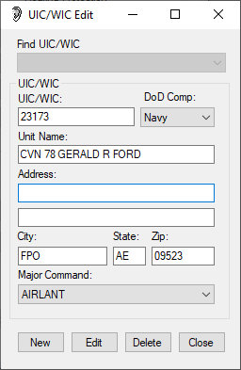
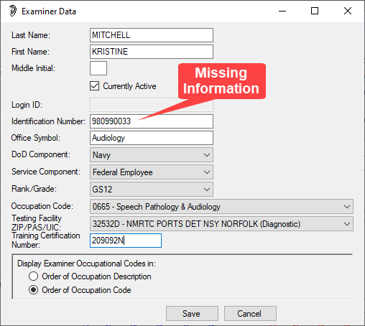
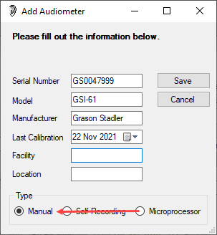
DOEHRS-HC Audiogram Entry Practicum
Create/Save UIC, Examiner, Audiometer
Linkage between the SSN and Certification number has to be correct
Tri-Service Hearing Technician 4.2.0.0 Certification Course
Notes:
UIC, Examiner, Audiometer window, ensure all data is correct prior to saving – entered with 2216; available for the 2215 drop-down window selection
Briefly review this and the following slides, asking if the students had any problems entering data
Enter data from evaluation, serial number, model, serial number, date of calibration
Facility and Location can be blank for manually entered audiometers
Audiologist uses a manual audiometer, ensure it was changed to manual =1 for the audiometer type on the audiogram
Review any trends you saw while checking DOEHRS-HC work stations

Slide 9
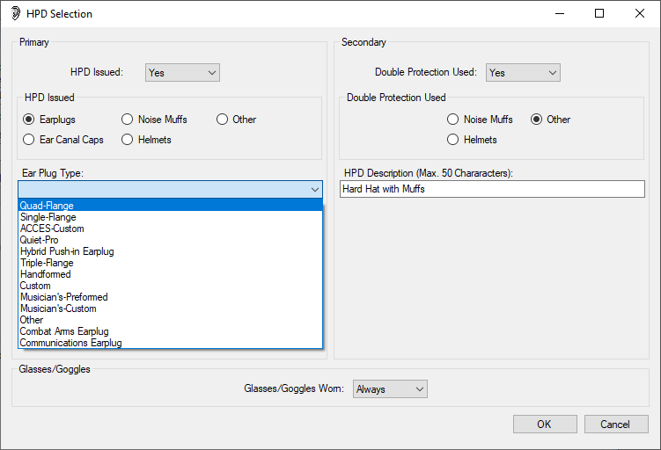
DOEHRS-HC Audiogram Entry Practicum
Hearing Protection Devices
Tri-Service Hearing Technician 4.2.0.0 Certification Course
Notes:
Enter data from demographic sheet or from the referral
Same data entry for DD Form 2215 or 2216
Review any trends you saw while checking DOEHRS-HC work stations

Slide 10
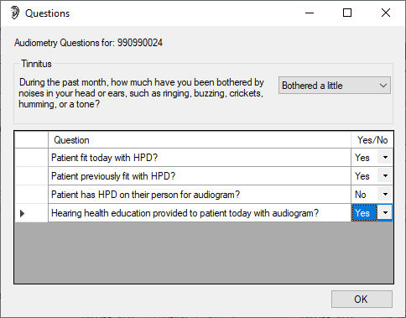
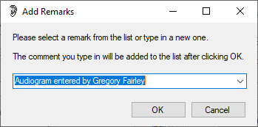
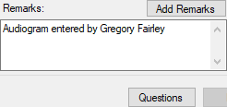
DOEHRS-HC Audiogram Entry Practicum
Questions, Electronic Remark
Tri-Service Hearing Technician 4.2.0.0 Certification Course
Notes:
Answer questions, add electronic remark – only enter remark once in the add remarks window; once saved they will autofill the “Remarks” section
Same data entry for a DD Form 2215 or 2216
Review any trends you saw while checking DOEHRS-HC work stations

Slide 11
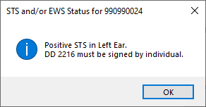
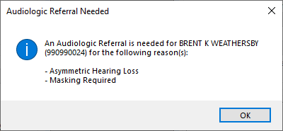
DOEHRS-HC Audiogram Entry Practicum
Prompt Windows
These prompts do not occur with the Reference Type 3 (re-establishment) data entry
Tri-Service Hearing Technician 4.2.0.0 Certification Course

Slide 12
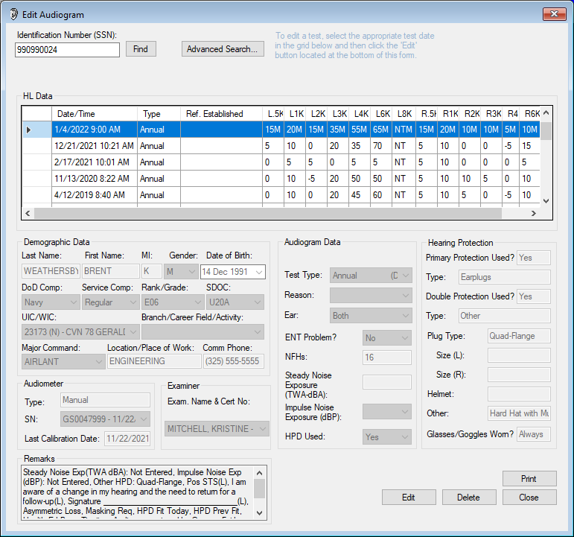
Notes:
Ensure students understand how sub-fields affect electronic audiograms
Review any trends you saw while checking DOEHRS-HC work stations

Slide 13
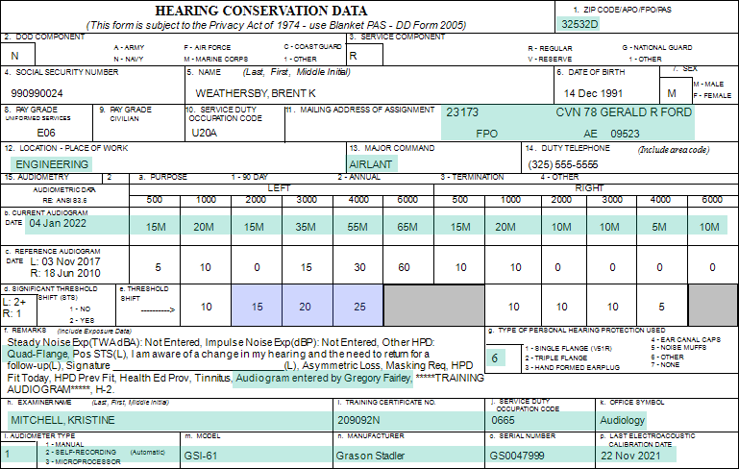
Notes:
Ensure students understand how sub-fields affect electronic audiograms
Review any trends you saw while checking DOEHRS-HC work stations
Counseling?

Slide 14
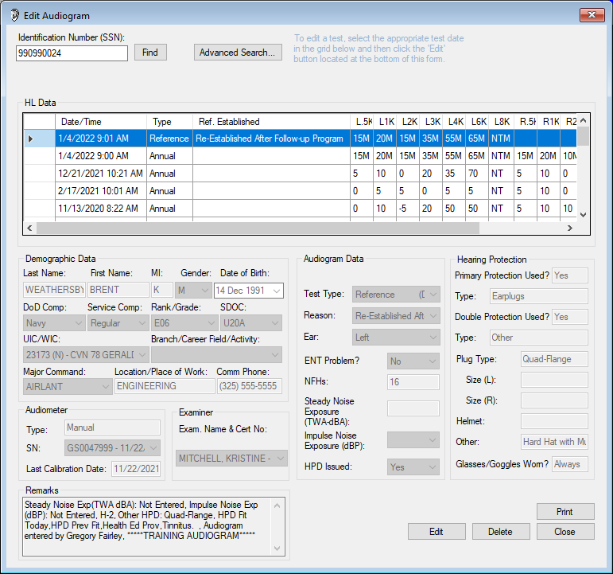
Notes:
Ensure students understand how sub-fields affect electronic audiograms
Review any trends you saw while checking DOEHRS-HC work stations

Slide 15
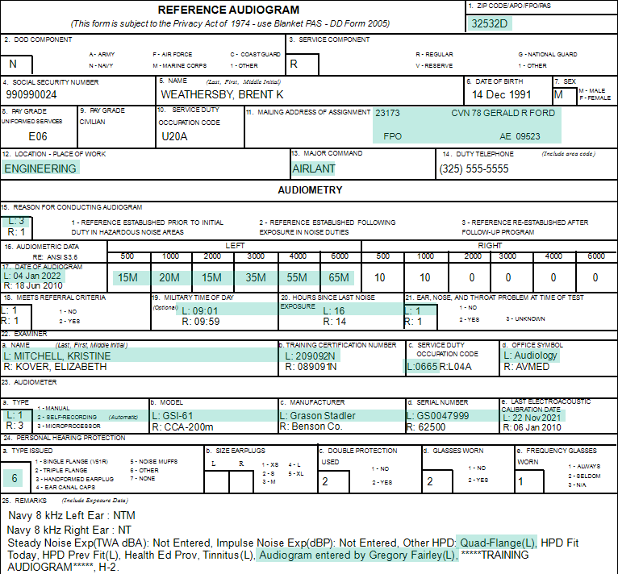
Notes:
Ensure students understand how sub-fields affect electronic audiograms
Review any trends you saw while checking DOEHRS-HC work stations

Slide 16
DOEHRS-HC Audiogram Entry Practicum
Summary
Manually enter audiograms from an audiological evaluation
Sub-table/fields data entry and how it affects patient audiograms
Examiner entry
Audiometer entry
Audiogram test site, date/time and thresholds entry
Tri-Service Hearing Technician 4.2.0.0 Certification Course

Slide 17
DOEHRS-HC Audiogram Entry Practicum
? Questions ?
Tri-Service Hearing Technician
4.2 Certification Course

